Slide 1
Identifying immune-related genes in calcific aortic valve stenosis
Ryan Byrne, Pratishtha Guckhool

Slide 2
Introduction
Calcific aortic valve stenosis (CAVS) is the most prevalent heart valve disorder in developed countries [1].
Studies have shown that 2.8% of the elderly have varying degrees of CAVS and 25% of those over the age of 65 have risk factors for CAVS [2].
Progression of CAVS has been associated with:
Older men
High triglyceride levels
Smoking time limit
Early aortic valve replacement

Slide 3
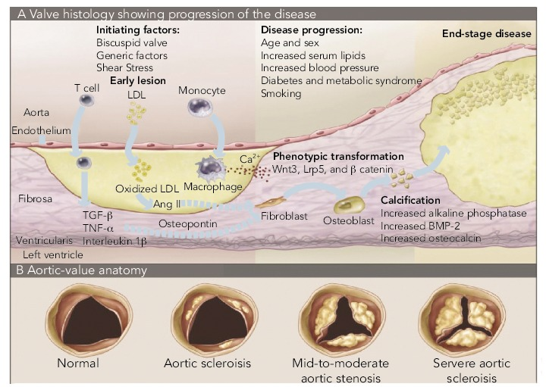
Introduction - Biology
CAVS is characterized by slowly progressive fibro-calcific remodelling of the aortic valve leaflets.
Calcific valve disease occurs as the result of lipoprotein deposition, chronic inflammation, osteoblastic transition of valve interstitial cells, and active leaflet calcification.

Slide 4
Goals
To identify immune related genes that may provide a better prediction of Calcific Aortic Valve Stenosis (CAVS) in an individual
Based on the differential gene expression analysis between the control and CAVS samples from training datasets
To predict whether an individual is suffering from CAVS based on the gene expression levels of the identified differentially expressed immune related genes

Slide 5
Training Dataset
Two training sets:
GSE12644
20 samples: 10 calcified aortic valve samples and 10 normal controls.
Expression values were extracted using the Robust Multichip Average method.
Robust multiarray average normalization.
GSE51472
15 samples: 5 normal aortic valve samples, 5 Sclerotic aortic valve samples, 5 Calcified aortic valve sample.
Microarrays used to detail the global programme of gene expression.
Robust multiarray average normalization.

Slide 6
Testing Set
GSE83453:
27 samples: 12 bicuspid aortic valve samples, 11 stenotic aortic valve samples, 12 normal aortic valve samples.
mRNA levels were measured using Illumina HumanHT-12 v4 Expression BeadChip.
Data was processed by log2-transformation and quantile normalized using the lumi package in R.
Illumina ID converted to gene symbol using R.

Slide 7
Methods - Analysis workflow
Combine the two training datasets
Differentially Expression
(|FC| > 1) and p-value < 0.05
Identify DEIRG using the Immport database
Support Vector Machine Recursive Feature Elimination model
Perform gene enrichment using DAVID
Perform gene enrichment using DAVID
Test Model Using Testing Set

Slide 8
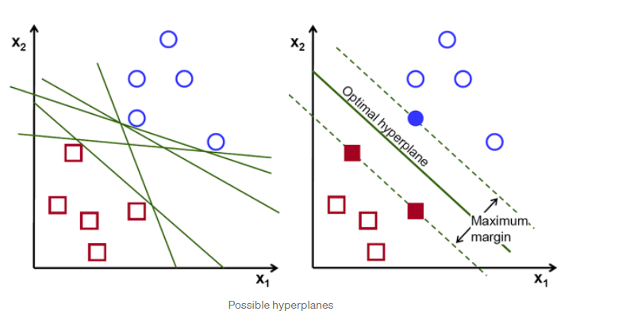
Support Vector Machine Recursive Feature Elimination
Support Vector Machine (SVM) algorithms attempts to find a hyperplane that distinctly classifies data points [4].
Recursive Feature Elimination (RFE) performs feature selection for difference in gene expression values to more accurately screen predictions [2].
RFE works by searching for a subset of features within a training dataset and removing features until the desired number of features remains [3].

Slide 9
Results
Differentially Expressed Immune Related Genes (DEIRG)
Immune and inflammatory response is a key pathological link to progress of CAVS [2].
Differentially expressed genes are defined as having an |log2 Fold Change| ± 1 and p-value < 0.05
280 DEGs
2483 IRGs were obtained from the ImmPort database
280 DE Genes are filtered for those that are within ImmPort database.
76 DEIRGs
8 down-regulated genes
68 up-regulated genes

Slide 10
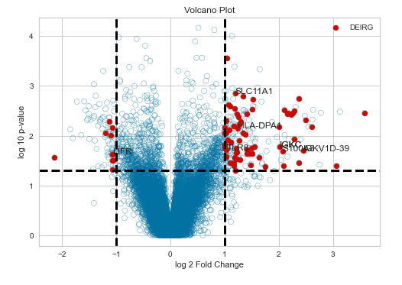
Volcano Plot

Slide 11
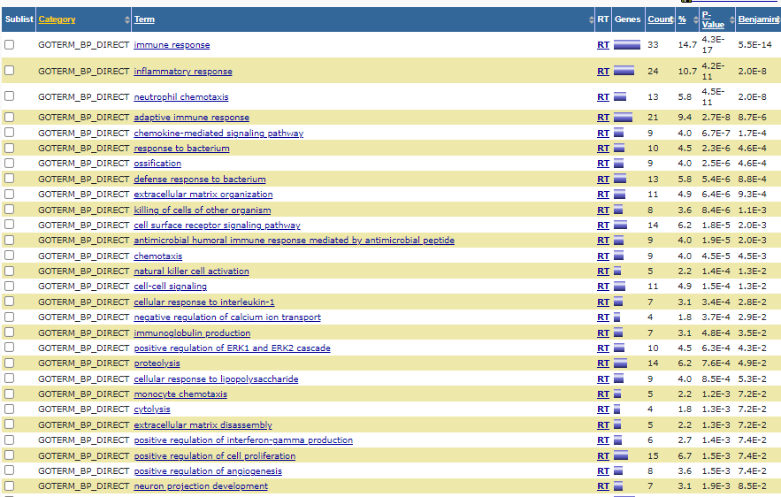
Differentially Expressed Pathway Analysis

Slide 12
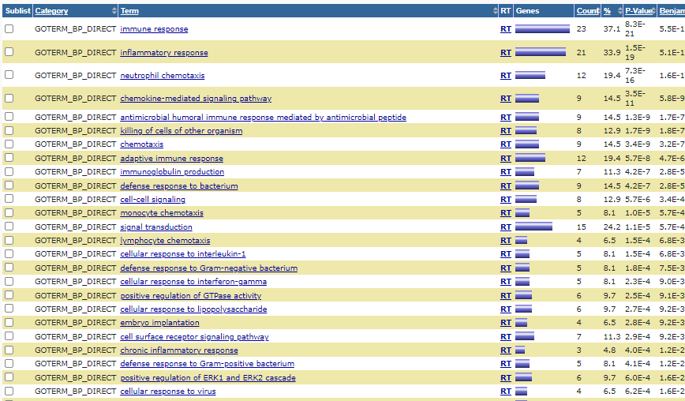
DEIRG Pathway Analysis

Slide 13
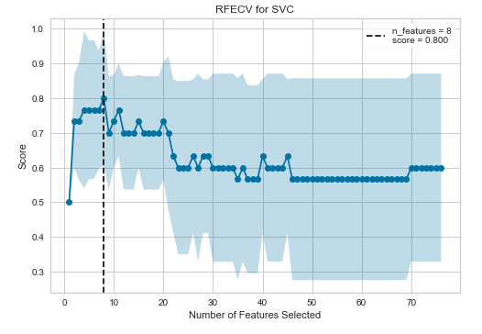
Finding Optimal Number of Features to Select

Slide 14
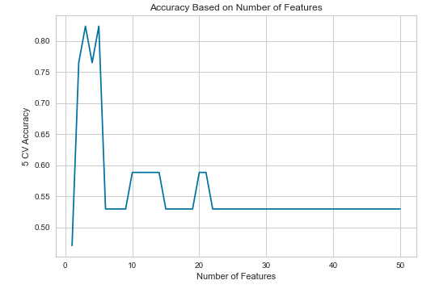
Machine Learning Accuracies

Slide 15
Five Most Correlated DEIRGs
LCK - LCK Proto-Oncogene, Src Family Tyrosine Kinase - Protein is a key signaling molecule in the selection and maturation of T-cells.
TLR8 - Toll Like Receptor 8 - As a member of the TLR family it plays a role in pathogen recognition and activation of innate immunity.
LIFR - LIF Receptor Subunit Alpha - Protein combines with converter subunit, gp130, to form a complex that mediates the action of the leukemia inhibitory factor.
ADIPOQ - Adiponectin, C1Q, and Collagen Domain Containing - Protein circulates the plasma and is involved in metabolic and hormonal processes.
S100A8 - S100 Calcium Binding Protein A8 - Protein functions in the inhibition of casein kinases and as a cytokine.

Slide 16
Conclusion
Calcific Aortic Valve Stenosis modulates expression of 260 genes of which 76 are immune related genes.
Differentially expressed immune related genes can be used to predict Calcific Aortic Valve Stenosis
Using a fewer number of genes produced better results
Limitations:
Not every gene in the testing set could be converted to gene symbol so only a subset of DEIRGs used for training,
Future studies include:
Repeat study with new subjects with and without CAVS
Screen patients with CAVs to see if differentially expressed genes are consistent

Slide 17
References
[1] Lindman, B. R., Clavel, M. A., Mathieu, P., Iung, B., Lancellotti, P., Otto, C. M., & Pibarot, P. (2016). Calcific aortic stenosis. Nature reviews Disease primers, 2(1), 1-28.
[2] Jiang, C., & Jiang, W. (2022). AGTR1, PLTP, and SCG2 associated with immune genes and immune cell infiltration in calcific aortic valve stenosis: analysis from integrated bioinformatics and machine learning. Mathematical Biosciences and Engineering, 19(4), 3787-3803.
[3] Brownlee, J. (2020, August 28). Recursive feature elimination (RFE) for feature selection in Python. Machine Learning Mastery. Retrieved May 31, 2022, from https://machinelearningmastery.com/rfe-feature-selection-in-python/
[4] Gandhi, R. (2018, July 5). Support Vector Machine - introduction to machine learning algorithms. Medium. Retrieved May 31, 2022, from https://towardsdatascience.com/support-vector-machine-introduction-to-machine-learning-algorithms-934a444fca47

